Slide 1
Project presented 29th November 2018:
seasonal offer and fleet deployment
OOMP a.a. 2018-2019
Daniela Ambrosino
Federico Bartoli Itinerary Planning Director Revenue Management, Itinerary & Transportation Costa Crociere S.p.A.a
Notes:
To change the image on this slide, select the picture and delete it. Then click the Pictures icon in the placeholder to insert your own image.

Slide 2
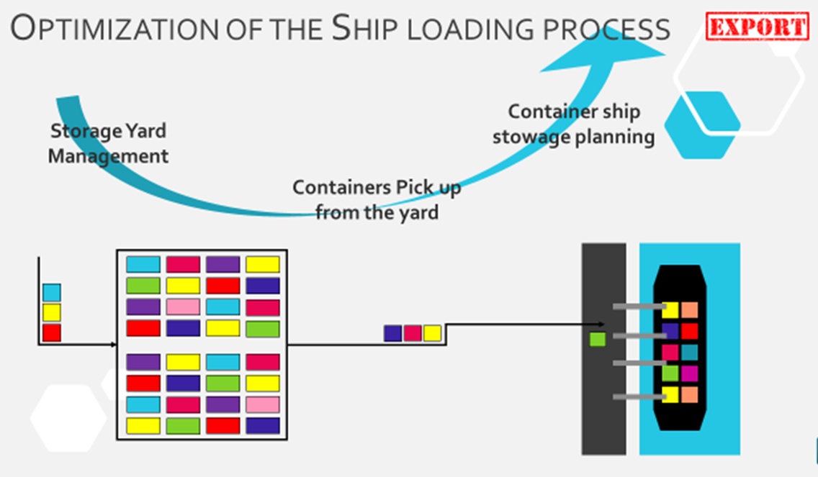
Project presented January 2019:
OOMP a.a. 2018-2019
Daniela Ambrosino
Anselmo Marcenaro
Ships specialist and trainer - Operation Support
PSA – Genova Pra
Notes:
To change the image on this slide, select the picture and delete it. Then click the Pictures icon in the placeholder to insert your own image.

